Slide 1
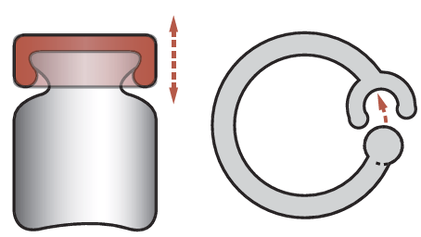
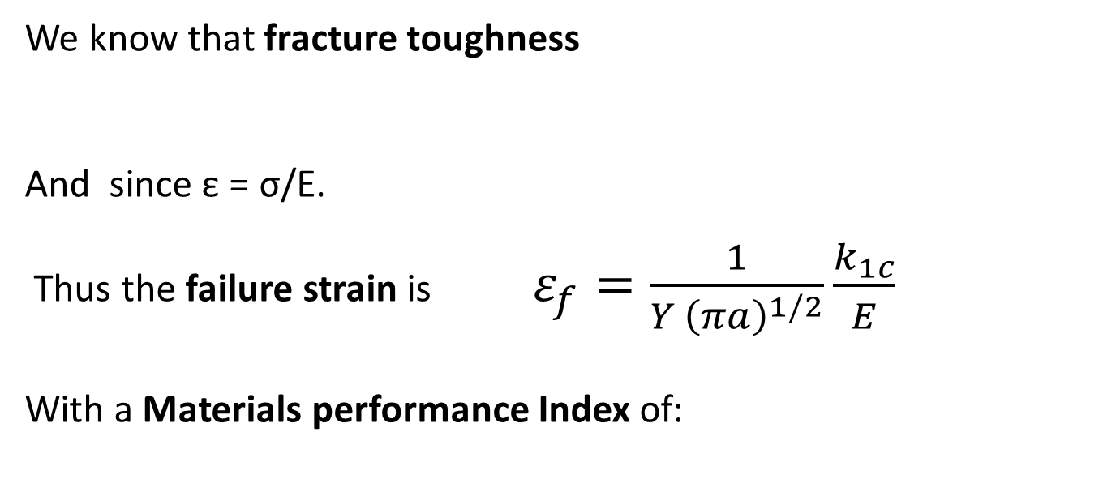
Deflection Limited Design: Snap clips/lids
Function: Resist brittle failure
Objectives: Secure fitting or lid
Constraints: Deflection specified by design
at low cost
Free variable: Choice of material
We know that fracture toughness
And since ε = σ/E.
Thus the failure strain is $ε_{f}=\frac{1}{Y {\left(πa\right)}^{1/2}}\frac{k_{1c}}{E}$
With a Materials performance Index of:

Slide 2
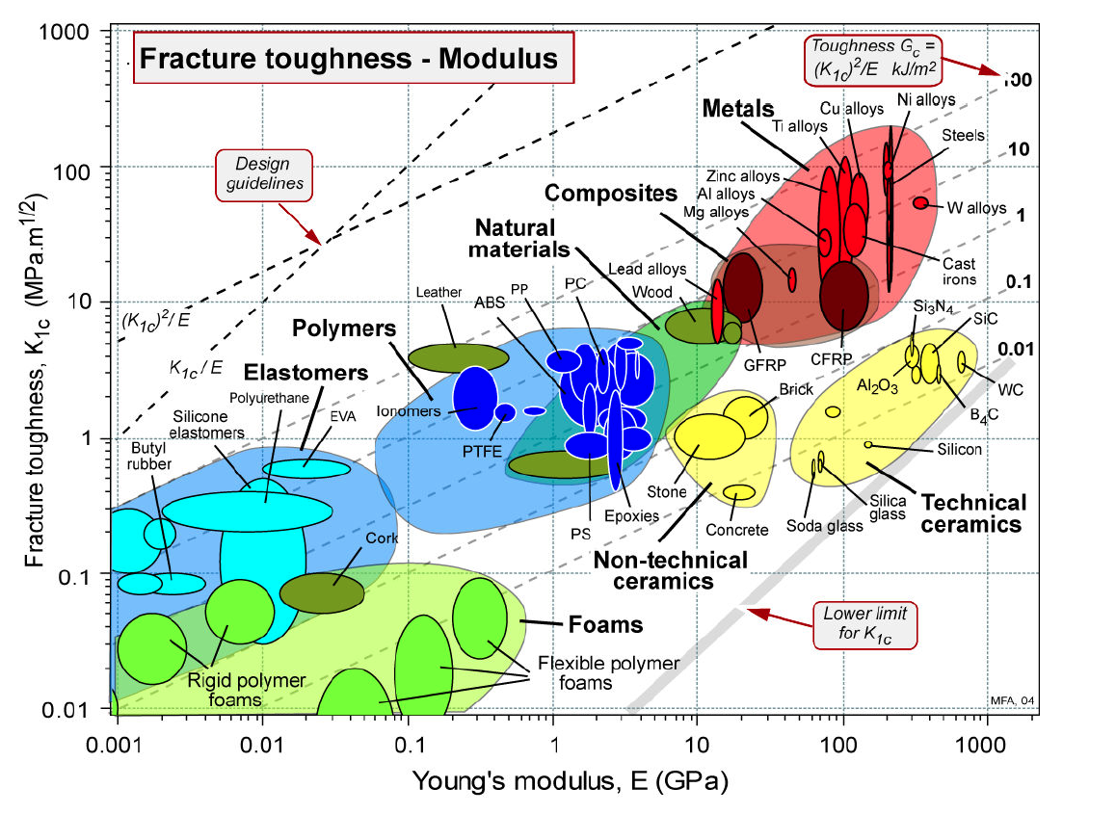

Slide 3
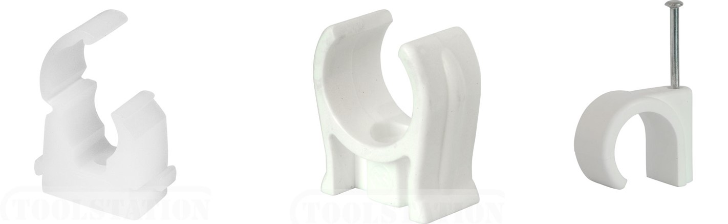
Deflection Limited Design: Snap clips/lids
From the K_{1c} versus E selection chart the most likely polymer for these clips is polypropylene

Slide 4
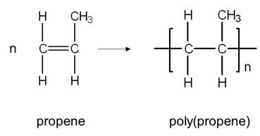
Polypropylene
Polypropylene(PP) is the second most widely used polymer after Polyethylene(PE). PP is more rigid than PE, used in tapes, plastic bottles, caps of bottles, car parts, (also fibre-reinforced), textiles (ropes, carpet fibres).
PP like PE is a Vinyl polymer made from vinyl monomers; that is, small molecules containing carbon-carbon double bonds.
Notes:
Methyl group CH3

Slide 5
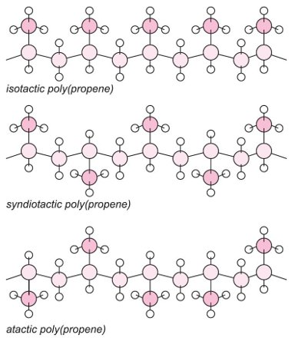
Structure – Properties – Processing
Tacticity
Arrangement of covalently bonded atoms around asymmetric carbon atoms.
Three possible forms:
  Isotactic (the same side)
  Syndiotactic (alternating symmetrically)
  Atactic (random manner)

Slide 6
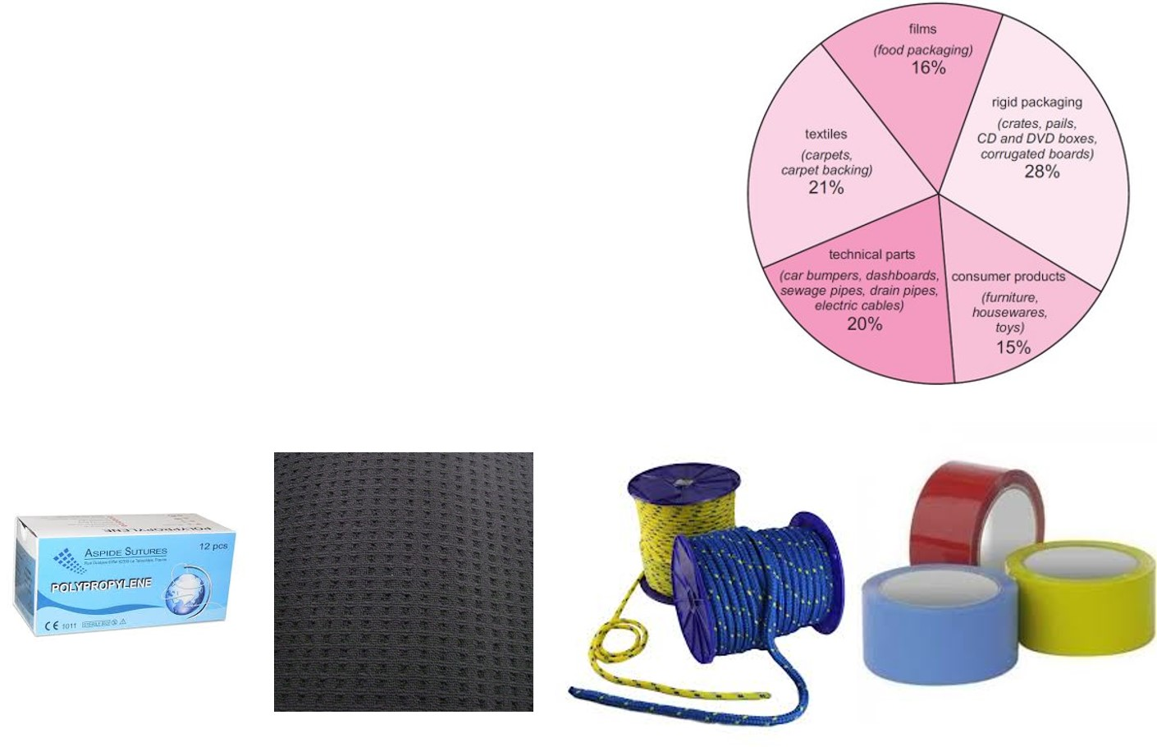
Structure – Properties – Processing
60% of the total production of PP is as a homopolymer.
PP is one of the light thermoplastics
Typical density 0.905 g cm⁻³ with
T_{m} ~167˚C, and T_{g} ~ -20˚C
and a crystallinity of ~ 50-60%.
PP, unlike PE, is transparent.

Slide 7
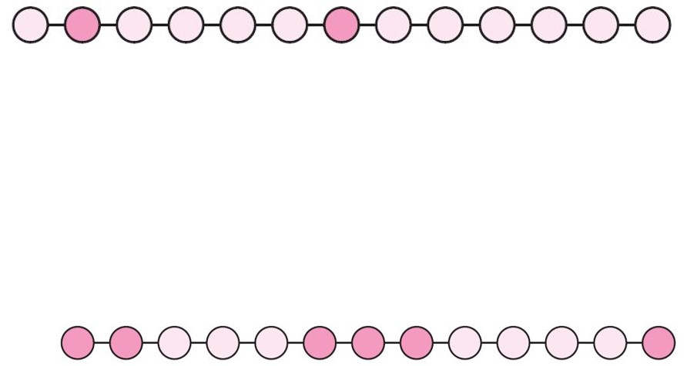
Structure – Properties - Processing
PP Co-polymers
Random co-polymers - polymerising together ethylene and propene. Ethylene units, usually up to 6% by mass, are incorporated randomly in the poly(propene) chains
The crystallinity and melting point are reduced and the products are more flexible and are optically much clearer. Random co-polymers are used for medical products (pouches, vials and other containers) and packaging (for example, bottles, CD and video boxes).
Block co-polymers - The ethylene content of the block co-polymer is larger (between 5 and 15%) than used in randomly alternating co-polymers.
It has rubber-like properties and is tougher than the random co-polymer…. useful in making crates, pipes, furniture and toys, where toughness is required.
When ethylene, propene and a third monomer, a diene, are polymerized, a rubber is formed, known as EPDM (Ethylene, Propene, Diene, polyMethylene).
Notes:
C2H4
While In organic chemistry a diene or diolefin is a hydrocarbon that contains two carbon double bonds

Slide 8
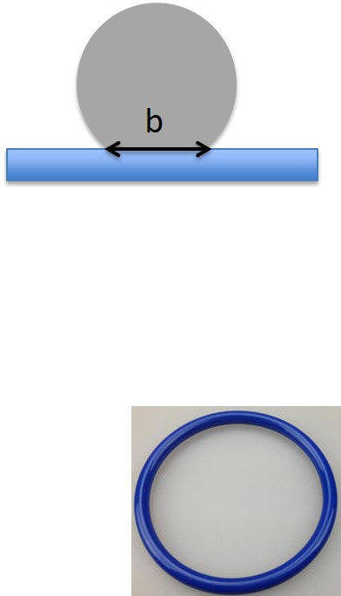
Elastic Seals
Function: Provide a tight elastic seal
Objectives: maximum conformity to surface
Constraints: limit on contact pressure required, low cost
Free variable: Choice of material
A materials in the shape of a cylinder of radius R and modulus E pressed into a flat surface will create a flat contact width, b, which is related the yield (or failure) stress and elastic modulus as follows*:
Thus contact width is maximised with a Materials Index of:
Make your selection from the following chart
*Proof on p155, section 6.9 of “Materials Selection in Mechanical Design, 4th Edition by M. F. Ashby

Slide 9
OR replot with Strength on y-axis so the Performance Index maximum is top left as normal…
See separate handout for expanded view

Slide 10
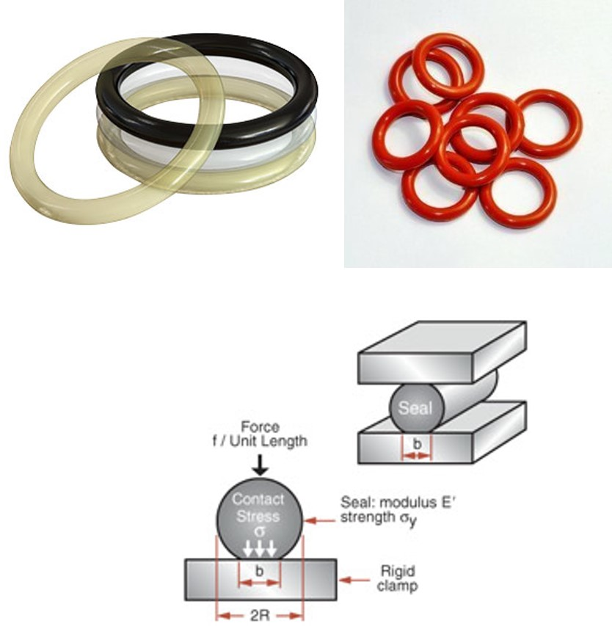
Elastic Seals
Elastomers have highest Materials index.
Polyurethane (PU) the best
especially when cost is a factor.
PU is widely used for seals.
Additional constraints (stability against chemicals and temperature, maximum stress to prevent damage) which may lead to other choices

Slide 11
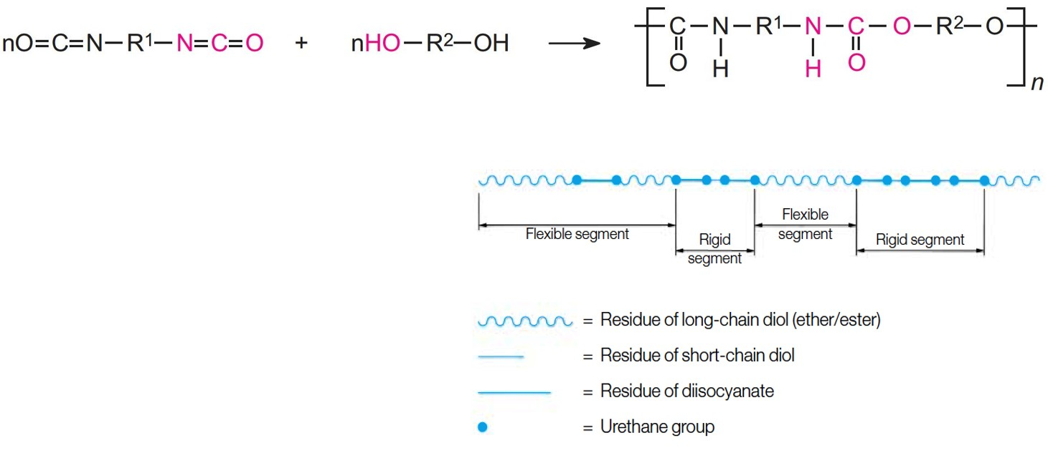
Structure – Properties – Processing
Polyurethanes PU is unlike most other polymers, there is no urethane monomer.
Polyurethanes are thermosets and are a class of block copolymers made by exothermic reactions between a diisocyanate and polyols (organic compounds containing multiple hydroxyl groups).
The group formed by the reaction between the two molecules is known as the urethane linkage.
Flexible segments are
created by the reaction of the polyol with the diisocyanate. The combination of diisocyanate with short-chain diol produces the rigid component (rigid segment)
Notes:
A polyol is an organic carbohydrate compound containing multiple hydroxyl groups (OH)
Isocyanates are a family of highly reactive, low molecular weight chemicals.
Thermoset plastics contain polymers that cross-link together during the curing process to form an irreversible chemical bond. The cross-linking process eliminates the risk of the product remelting when heat is applied, making thermosets ideal for high-heat applications such as electronics and appliances.
Most polyurethanes are thermosets, however thermoplastic polyurethanes are also available.

Slide 12
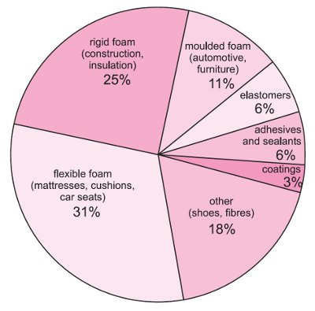
Structure – Properties – Processing
The physical properties and the chemical structure of polyurethane depend on the structure of the original reactants such as the R¹ and the R² groups.
The characteristics of the polyols - relative molecular mass, the number of reactive functional groups per molecule, and the molecular structure - influence the properties of the final polymer, and hence how it is used and makes it one of the most versatile polymers.
Polyurethane, PU
Density 1.12 to 1.24 g cm⁻³
T_{m} 120 -160˚C,
Wide range of T_{g} -60˚C to +60˚C

Slide 13
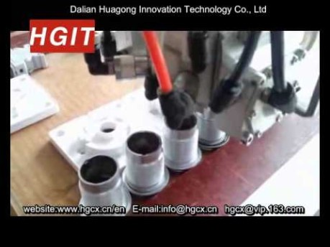
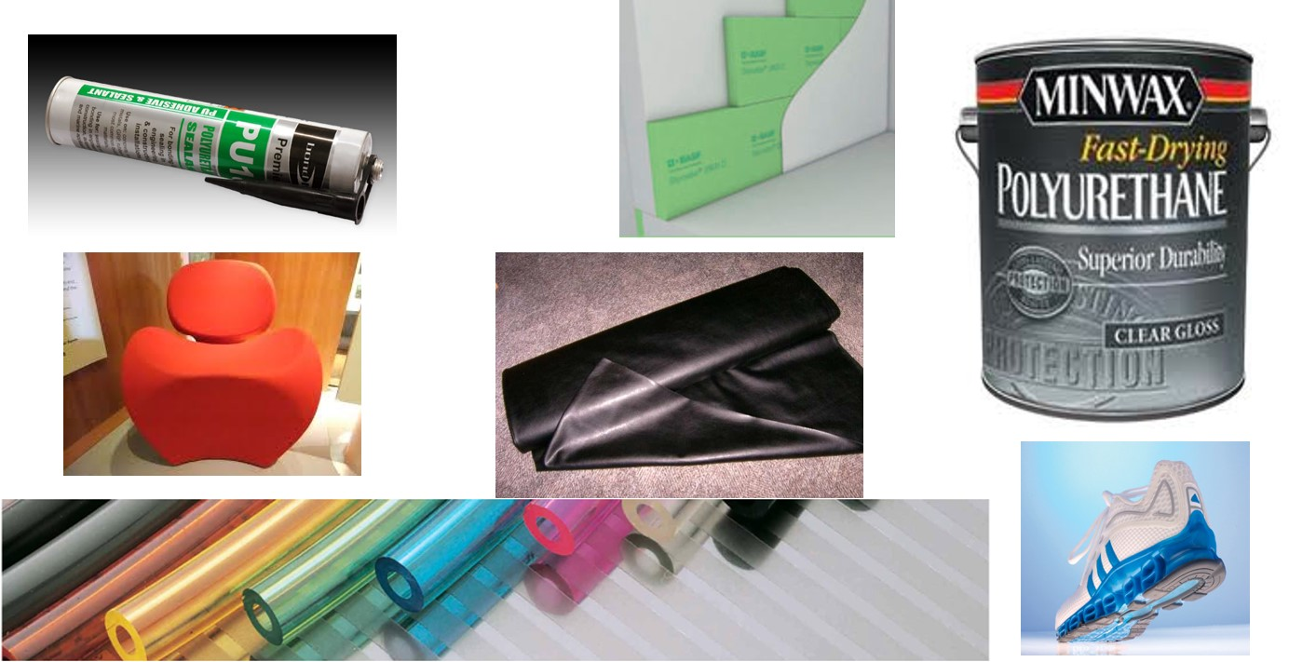
Structure – Properties – Processing
For example it can be used effectively in the sealing LINK of component parts from aerospace to household to medical devices to thermal insulation, moulded foam for furniture, coverings, electrical insulation, sealants, footwear, protective paint and so on …..
https://www.youtube.com/watch?v=Y0RDNpiQi-U

Slide 14
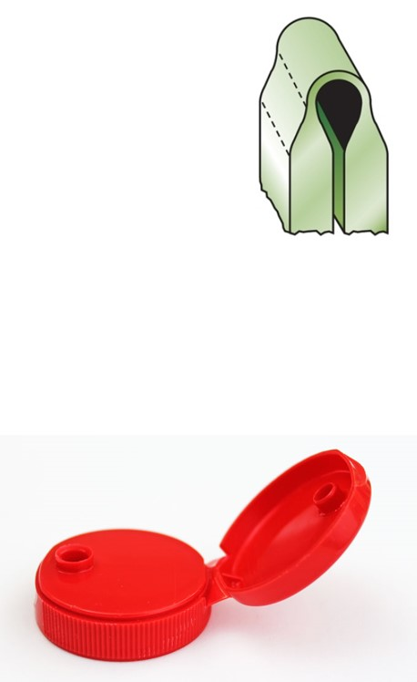
Elastic Hinges
Function: Recoverable elastic hinge
Objectives: Maximum elasticity without failure, i.e. minimum radius
Constraints: Must not fail
Free variable: Choice of material
The surface strain of hinge of thickness, t, and radius R is:
Thus maximum stress is:
Radius must be:
Want minimum radius so the Materials
Performance Index is related to 1/R so:
Notes:
Comment on how certain design requirements may have similar Materials indexes

Slide 15
OR replot with Strength on y-axis so the Performance Index maximum is top left as normal…
See separate handout for expanded view

Slide 16
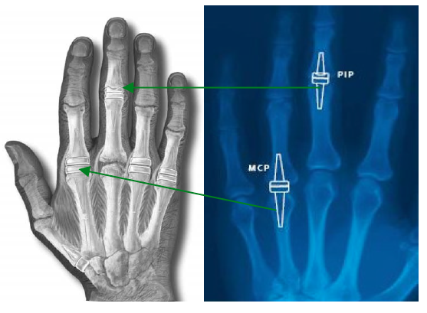
Elastic Hinges: finger implants
Elastomers show superior performance if you are not constrained by requiring a higher stiffness.
Additional constraints of cost, biocompatibility and durability
PU is 3-5 times more cheaper than silicone, but the materials cost is not often constraint on a medical implant (unless it is a high volume one like a catheter).
PU and silicone are both biocompatible and both have low surface energy which makes them hydrophobic.
However PU is used as candidate heart valve
material as it has higher toughness and
Strength and is non thrombogenic,
while silicone is used for finger joints
due to its durability at high strains
Notes:
Comment on how certain design requirements may have similar Materials indexes
non thrombogenic – will not allow for blood clotting
Need to check for other constrains

Slide 17
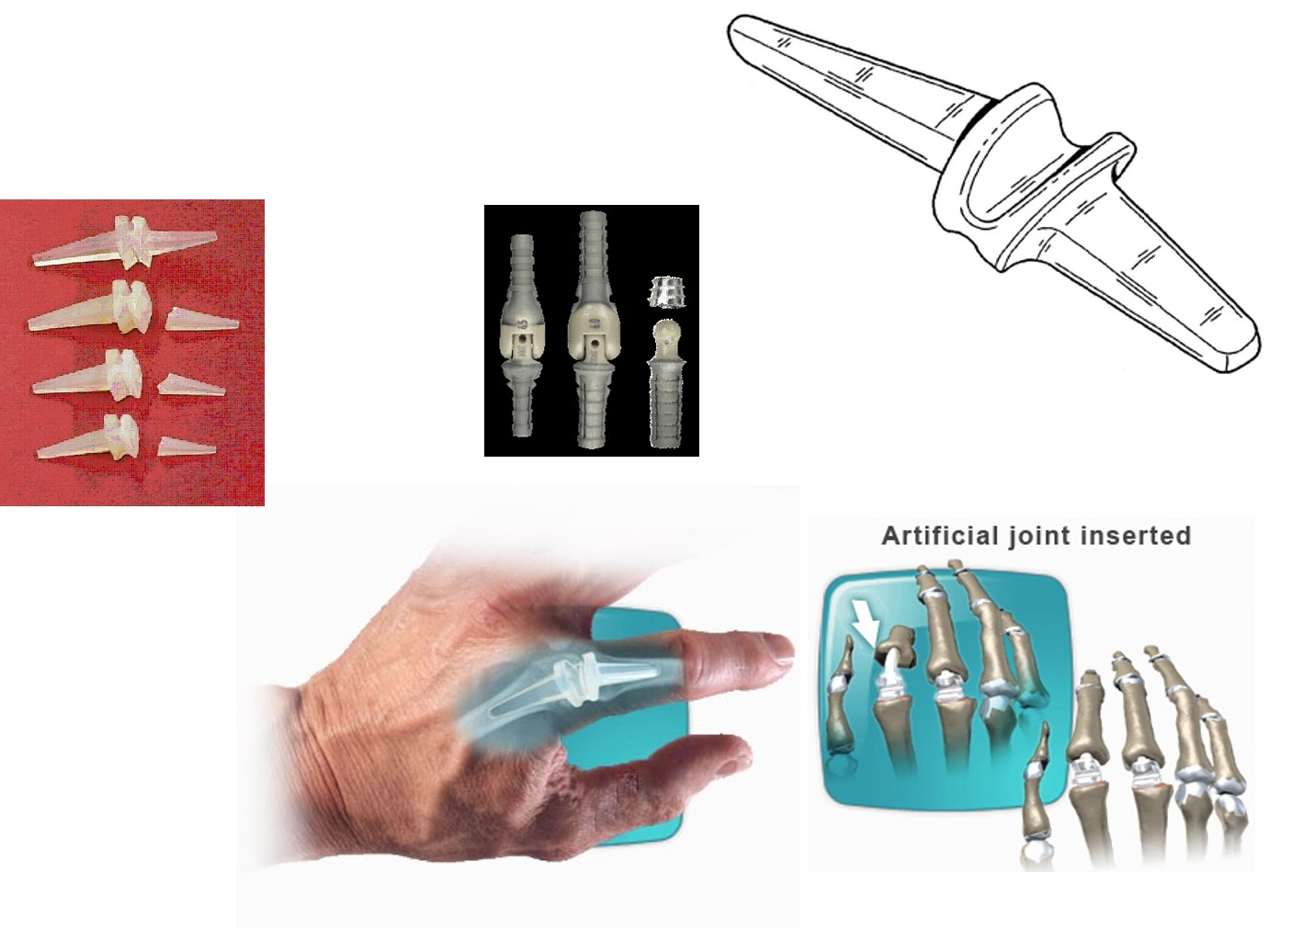
Finger Joint Replacement
http://www.fingerreplacement.com/DePuy/docs/Finger/Replacement/During%20Surgery/artificial_joint.html

Slide 18
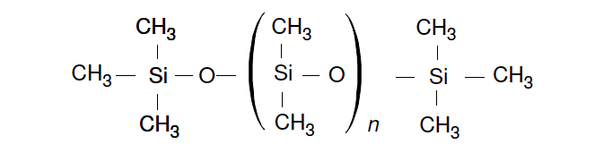
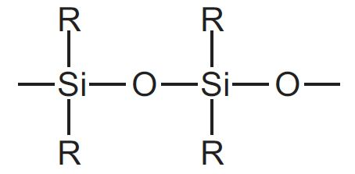
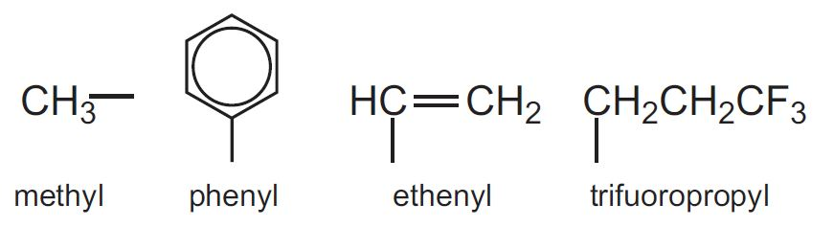
Structure – Properties – Processing
Silicones
Poly(dimethyl)siloxane (PDMS)
Most common silicones have methyl groups along the backbone.
Properties such as solubility in organic solvents, water-repellence and flexibility can be altered by substituting other organic groups for the methyl groups.
Silicones with phenyl groups are more flexible polymers than those with methyl groups. They are also better lubricants.
where R can be

Slide 19
Structure – Properties - Processing
Silicone fluids/ gels/ elastomers/ resins
Silicone Fluids have short chains, constant viscosity over a wide temperature range (-75 to 175˚C) and low vapour pressures.
The low surface tension of silicone fluids makes them ideal for lubricants in polishes, paints, water-proofing fabrics, paper and leather.
They also have anti-foaming properties.
Low enthalpy of vaporization and a smooth and silky feel and thus are used for personal care products such as skin care lotions.
Silicone gels - few crosslinks between the chains, giving it a very open three-dimensional network.
Crosslinking is done after a silicone fluid, together with a reactive group, is poured into a mould and then warmed or catalysed.
Used for protecting sensitive electronic equipment from damage from vibration and also acts as an electrical insulator. Pads containing a silicone gel - shock absorbers in shoes.
Notes:
warmed or catalysed via thermal or chemical crosslinking
low vapour pressure means less tendency to convert into vapour phase

Slide 20
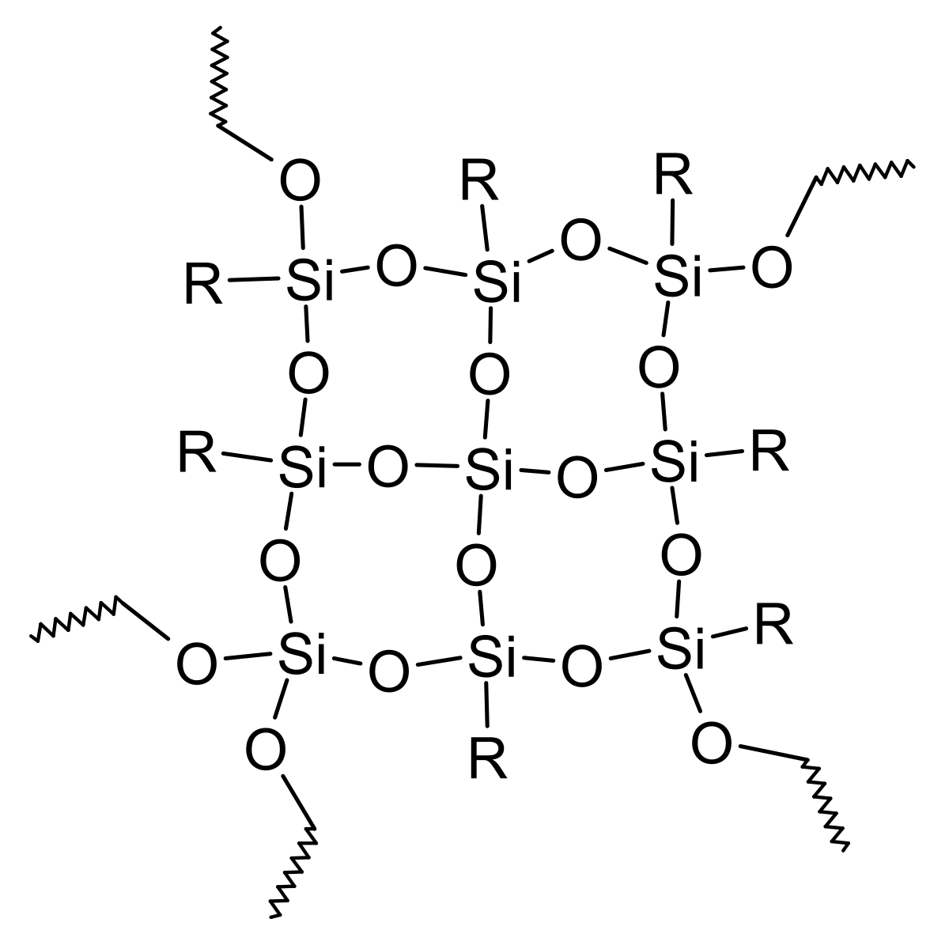
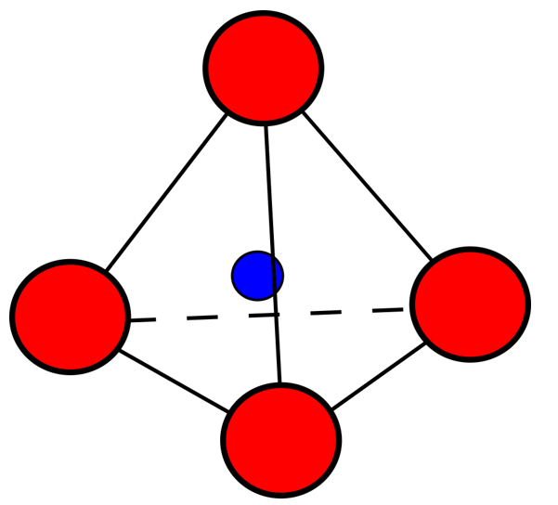
Structure – Properties – Processing
Silicone elastomers - Their structure is determined by the degree of crosslinking and the length of the chains.
Strength at room temperatures is inferior to that of natural rubber, but silicone rubbers are more stable at both low temperatures -75 ˚C and high temperatures > 175 ˚C and more resistant to chemical attack. Silica is added as a filler to make the elastomer stronger.
Silicone resins - have a three-dimensional structure with the atoms arranged tetrahedrally about the silicon atoms.
Applied in solution with an organic solvent - electrical insulating varnish or paints where water repulsion needed.
Also used as an anti-stick surface for working with sticky foods. Hydroxyl groups on the resin react with hydroxyl groups on surfaces such as silica and glass, thus making the surface water-repellent.
A large range of silanes, which act as coupling agents, allows glass, minerals and metals to bond to organic polymers such as the acrylics, polyamides, urethanes and polyalkenes. Similar mechanisms enable silicone resins to be used as adhesives.
Notes:
crosslinking of silicone resins can be catalysed using many metal-organics or acid/base catalysts

Slide 21

Structure – Properties - Processing
Silicone widely used in all industries. For example
Transport and Aerospace Applications
Silicone rubber in various forms is used to seal and protect parts such as:
door seals
windows seals
engine gaskets
lighting gaskets
vibration dampening
overhead lockers
instrument panels
vent ducts
electrical wires
protective coatings
encapsulants that withstand stresses and temperature extremes.

Slide 22
Block P: learning objectives
We explored the process-structure-property interrelationships for polymers using a detailed case study of low pressure gas distribution pipes polymers combined with other applications such as Acetabular cup- hip replacement, Snap on lids/clips (Deflection limited design), Seals and Elastic hinges (finger)
We Identified the influencing materials properties for designs and be able to generate a materials selection criteria that was then used to select initial appropriate materials for the polymer applications. Additional criteria were also explored.
We also demonstrated an understanding of the range of materials properties and their associated design requirements
We explored and the interrelationship between manufacturing, processes and materials properties and related it back to the structure –properties- principles interaction

Slide 23
BLOCK P: Designing with polymers
Concluding remarks
If you have enjoyed expanding your polymer knowledge in this Design with Polymers block then you may like to choose MMME/4094/01 – Polymer Engineering as an option later in your course
Notes:
Some notes on recycling
Polyurethane Recycling Processes
Polyurethane is recycled in two primary ways: mechanical recycling, in which the material is reused in its polymer form, and chemical recycling that takes the material back to its various chemical constituents.
Mechanical Recycling
Rebonded Flexible Foam—Rebonded flexible foam or “rebond” is made with pieces of chopped flexible polyurethane foam and a binder to create carpet underlay, sports mats, cushioning and similar products. Rebond has been used for decades and represents nearly 90 percent of the carpet underlay market in the United States.
Regrind or Powdering—Sometimes called powdering, regrind recycling takes polyurethane industrial trim or post-consumer parts and grinds them in various ways to produce a fine powder. The resultant powder is mixed with virgin materials to create new polyurethane foam or reaction injection molded (RIM) parts.
Adhesive Pressing/Particle Bonding—These two recycling processes use polyurethane from various applications, such as automobile parts, refrigerators and industrial trim, to create boards and moldings, often with very high recycled content. Used polyurethane parts are granulated and blended either with a powerful binder or polyurethane systems, then formed into boards or moldings under heat and pressure. The resulting products, analogous to particleboard made from wood waste, are used in sound proofing applications, furniture that is virtually impervious to water and flooring where elasticity is needed.
Compression Molding—This recycling process grinds reaction injection molded (RIM) and reinforced RIM parts into fine particles and then applies high pressure and heat in a mold, creating products with up to 100 percent recycled content and material properties that can be superior to virgin materials.
Chemical Recycling
Glycolysis—This process combines mixed industrial and post-consumer polyurethanes with diols at high heat, causing a chemical reaction that creates new polyols, a raw material used to make polyurethanes. These polyols can retain the properties and functionality of the original polyols and can be used in myriad applications.
Hydrolysis—This process creates a reaction between used polyurethanes and water, resulting in polyols and various intermediate chemicals. The polyols can be used as fuel and the intermediates as raw materials for polyurethane.
Pyrolysis—This process breaks down polyurethanes under an oxygen free environment to create gas and oils.
Hydrogenation—Similar to pyrolysis, hydrogenation creates gas and oil from used polyurethanes through a combination of heat and pressure and hydrogen.

